Slide 1
Model Engineering
Course material at: https://git.io/fjFga
Tuesday, Lecture 1
FASE ML Bootcamp
Based on material from:
Elements of Statistical Learning by Hastie, Tibshirani, Friedman,
Theory and Applications of Boosting by Schapire

Slide 2
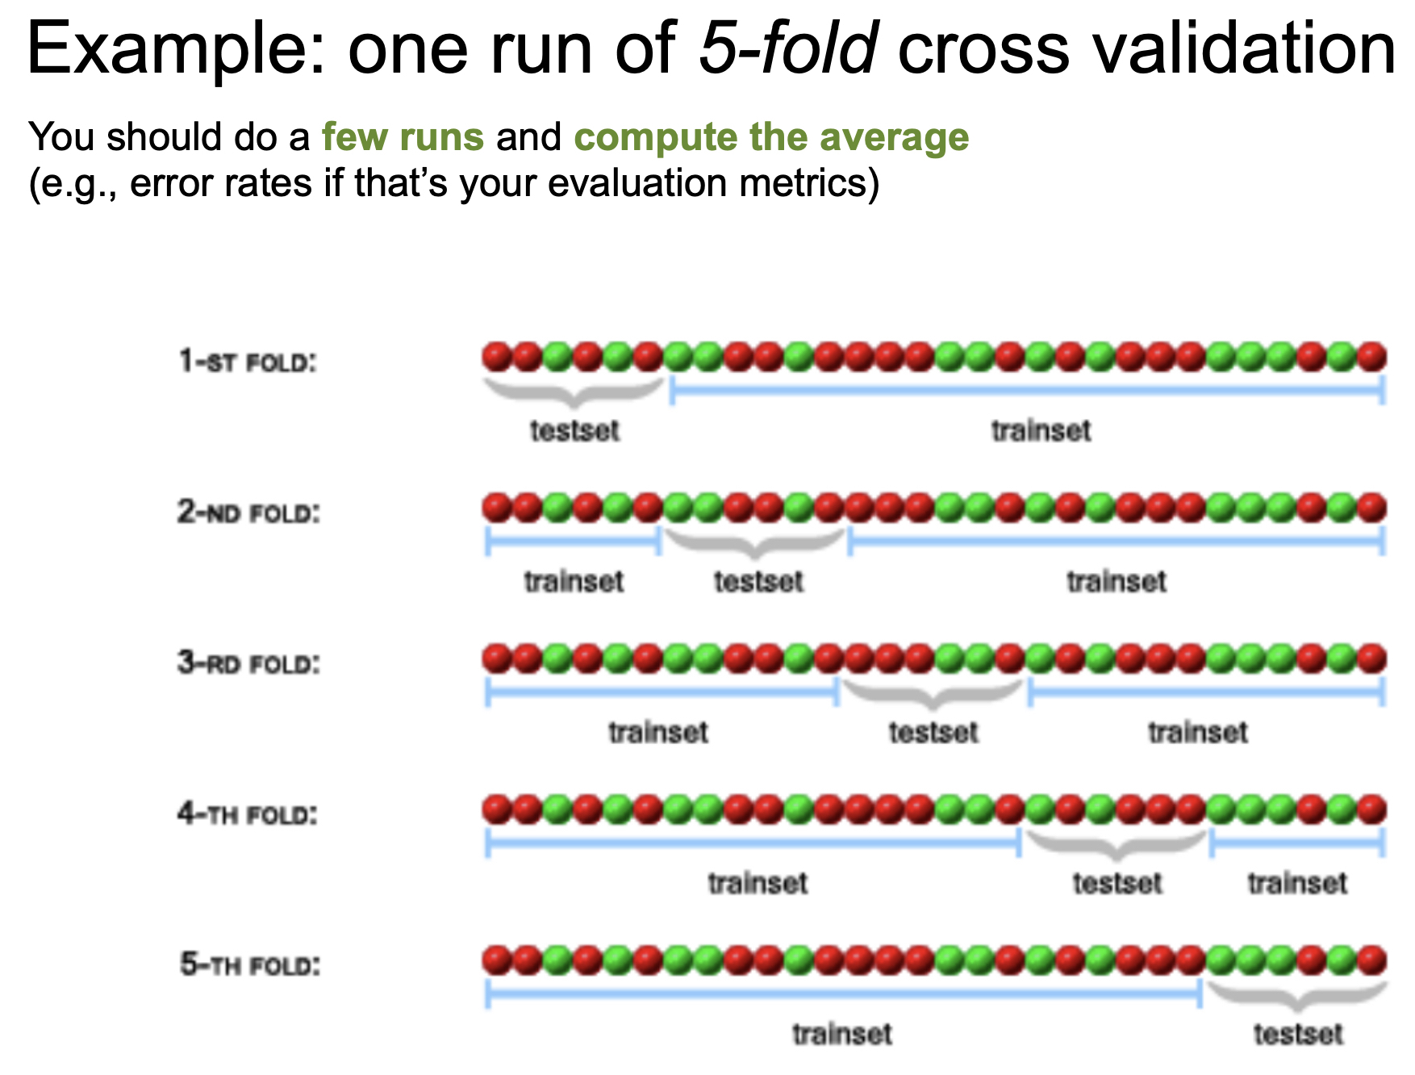

Slide 3
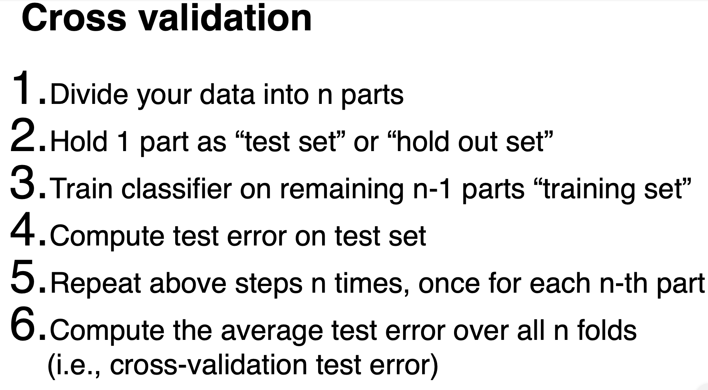

Slide 4
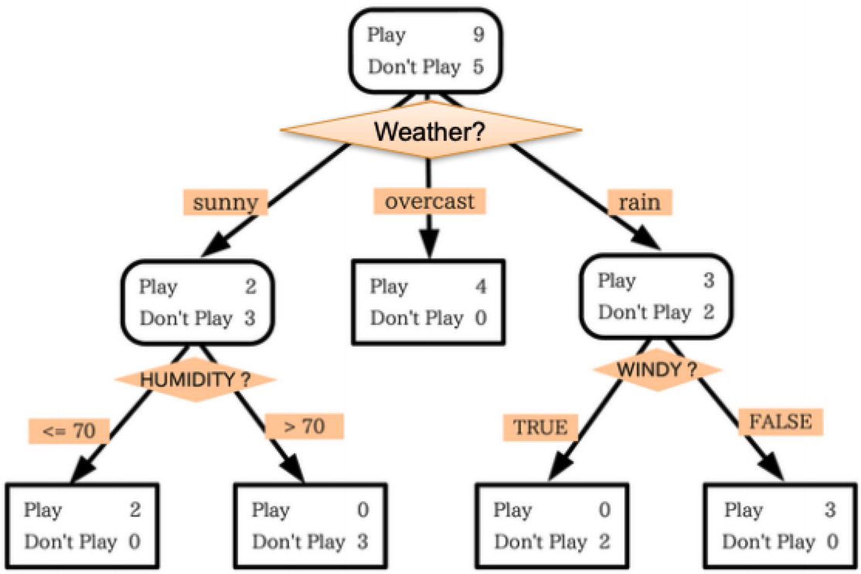
Model Combination
Any single model may have high variance in its predictions
Decision tree: predictions can be brittle, small perturbation in data can lead to misclassification
Creating more stable models:
Come up with a completely new model
Combine (unstable) models intelligently!

Slide 5
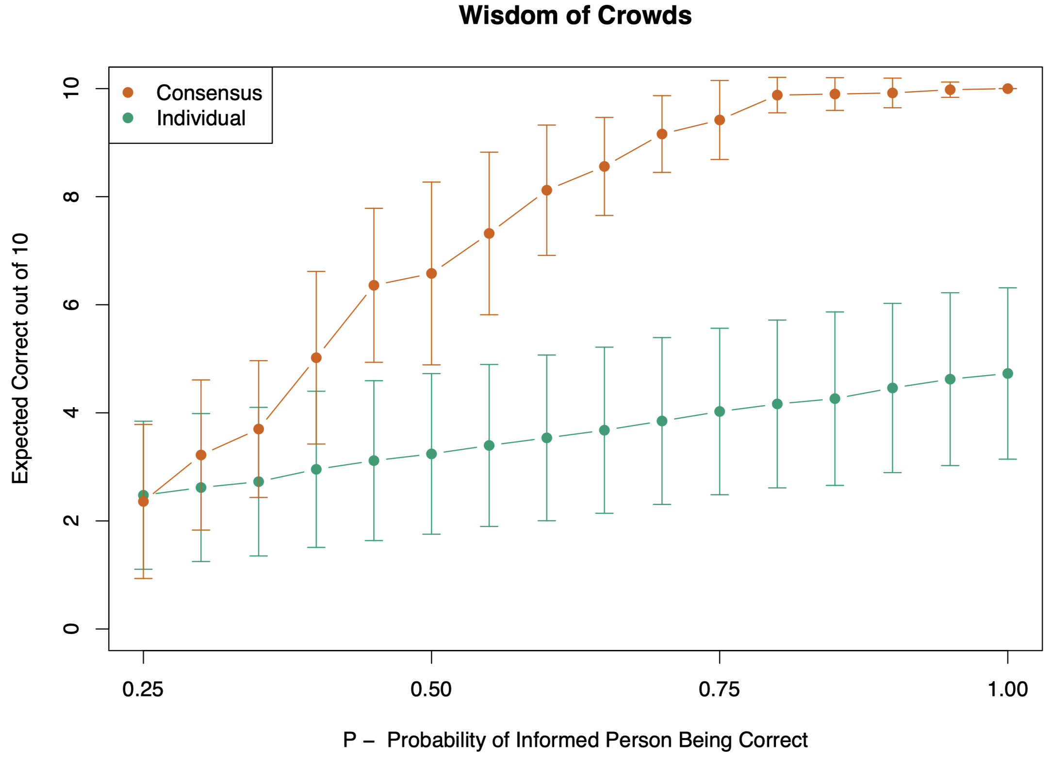
50 members vote in 10 categories, each with 4 nominations. For any category, only 15 voters have some knowledge, represented by their probability of selecting the “correct” candidate in that category (so P = 0.25 means they have no knowledge).
For each category, the 15 experts are chosen at random from the 50.
Results show the expected number of correct decisions (based on 50 simulations) for the consensus, as well as for the individuals. The error bars indicate one standard deviation.
We see, for example, that if the 15 informed for a category have a 50% chance of selecting the correct candidate, the consensus doubles the expected performance of an individual.
Simulated academy awards voting
Elements of Statistical Learning, Figure 8.11

Slide 6
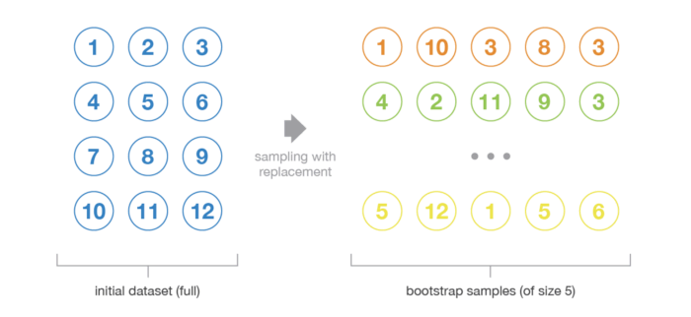
Bootstrap Sampling
Data: S = {(x_{i}, y_{i})}_{i = 1,…,n}
Bootstrap Sample: subsample of S, drawn with replacement
https://towardsdatascience.com/ensemble-methods-bagging-boosting-and-stacking-c9214a10a205

Slide 7
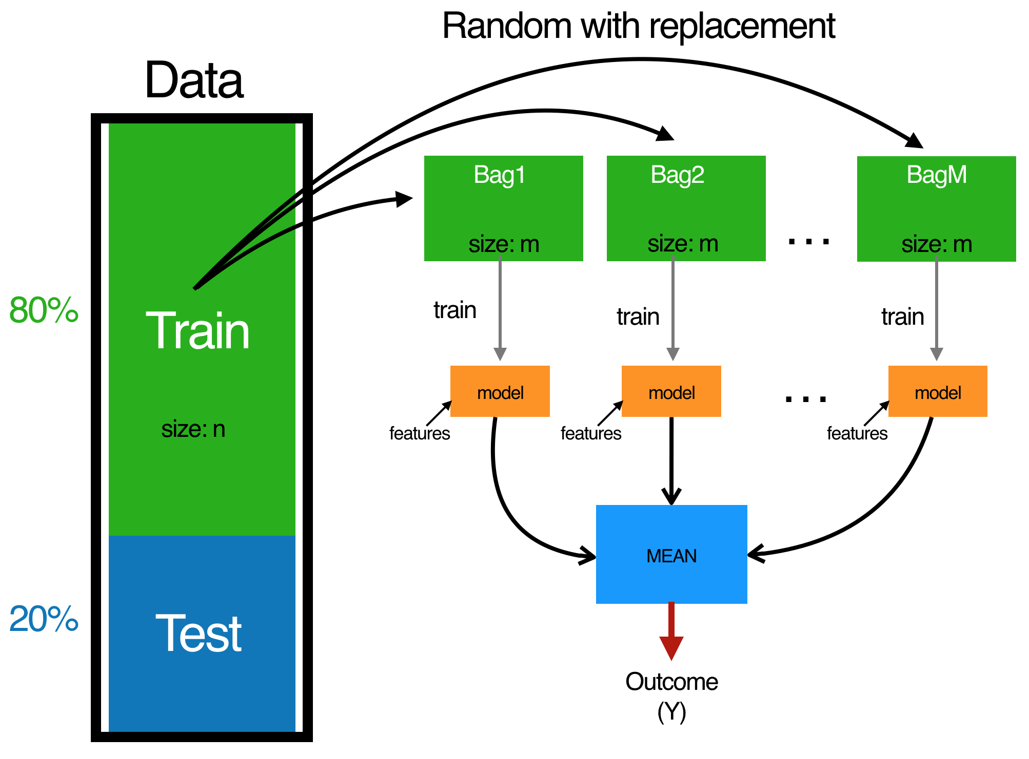
Bootstrap Aggregating (Bagging)
http://www.ub.edu/stat/docencia/EADB/bagging.html

Slide 8
Bagging
Aggregation:
Majority vote!
Benefits:
Even if single model overfits, on average they will not
http://www.ub.edu/stat/docencia/EADB/bagging.html

Slide 9
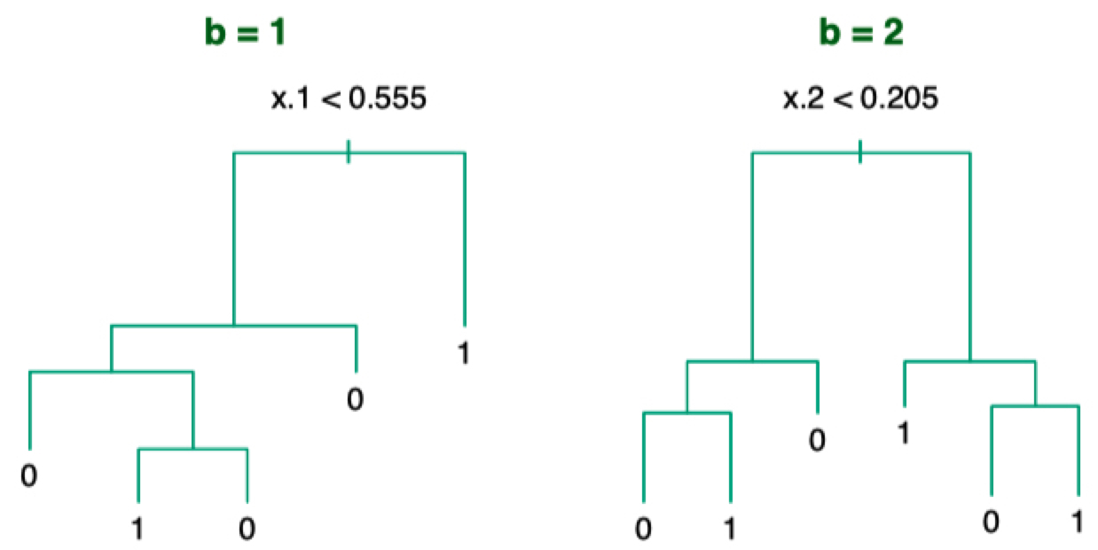
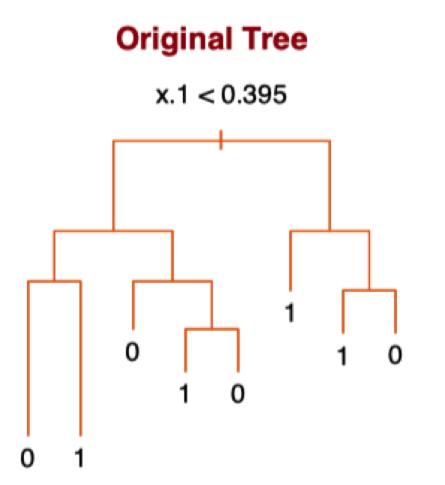
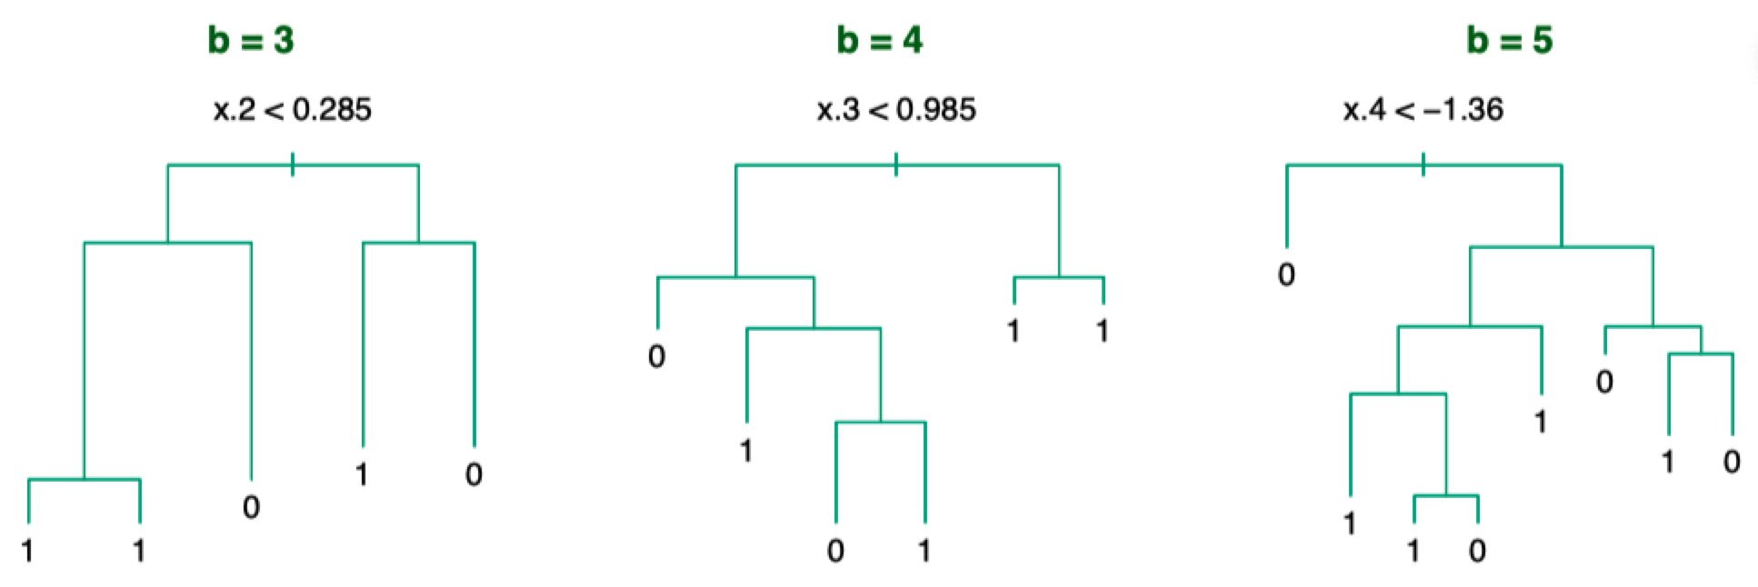
Bagging with Decision Trees
Elements of Statistical Learning, Chapter 8.7

Slide 10
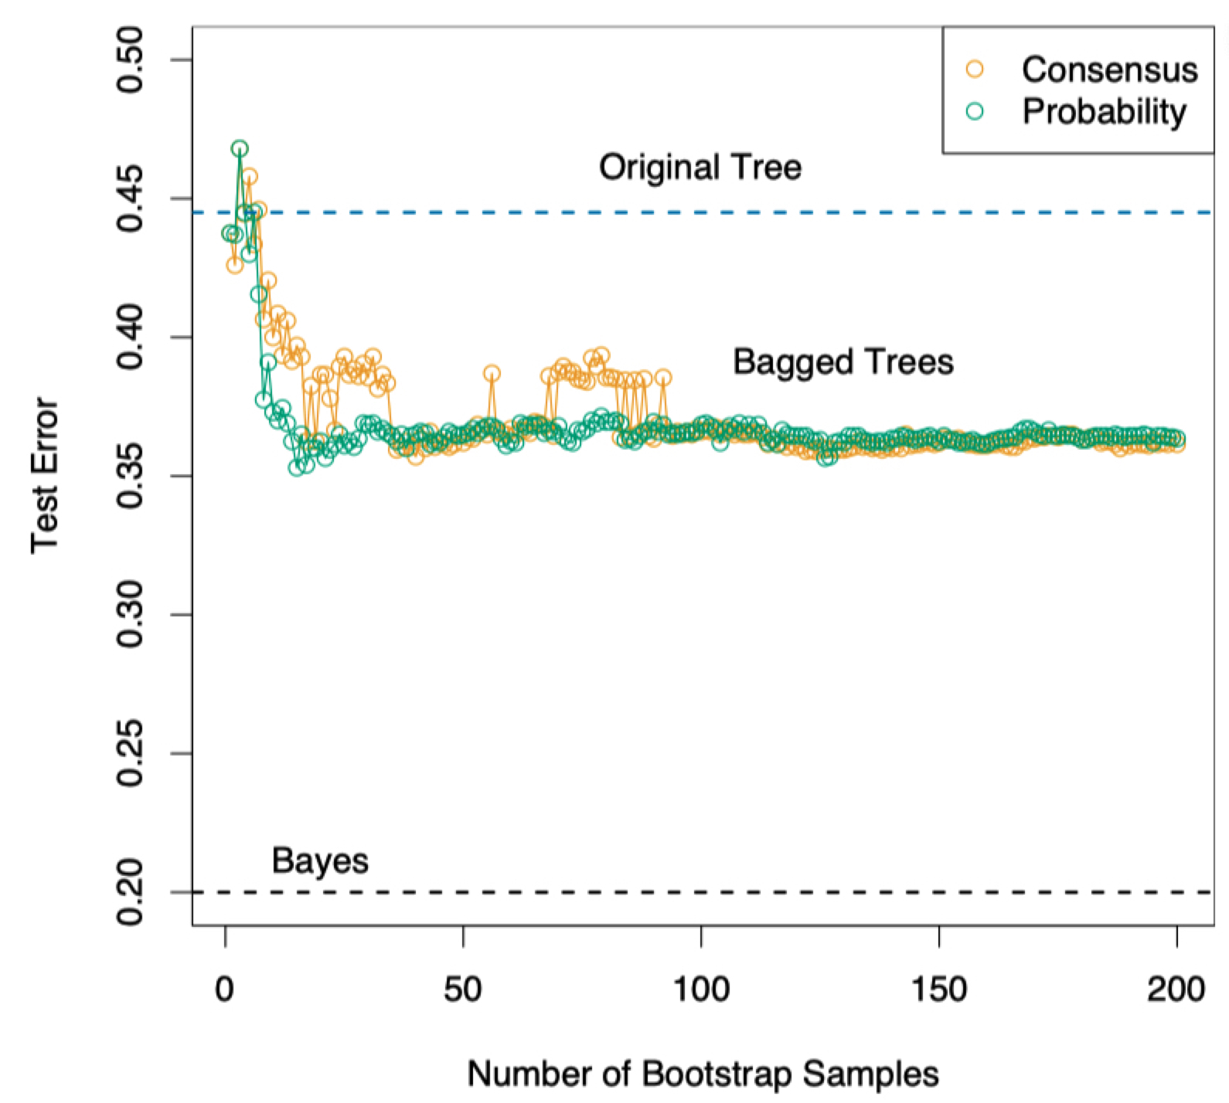
Predicting with bagged decision trees
Consensus: proportion of trees that predict a given class
Probability:
For b-th tree, look at the leaf corresponding to test sample
What proportion of the training data had the same label as test sample?
Average those proportions out
Prediction: in both cases, predict class with highest score
Elements of Statistical Learning, Chapter 8.7

Slide 11
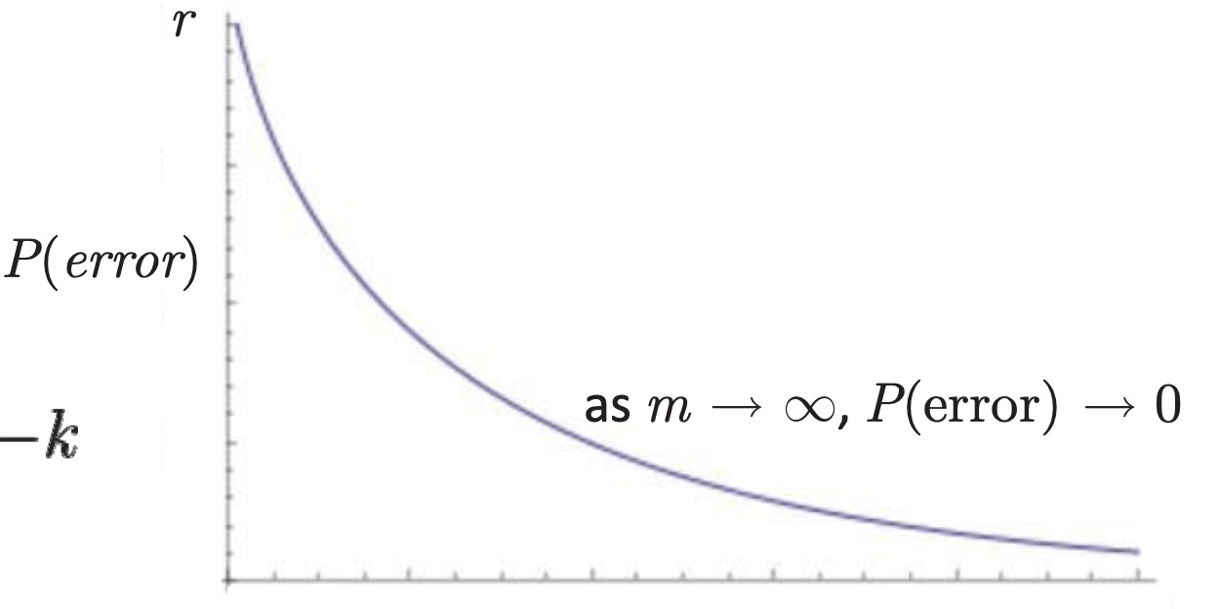
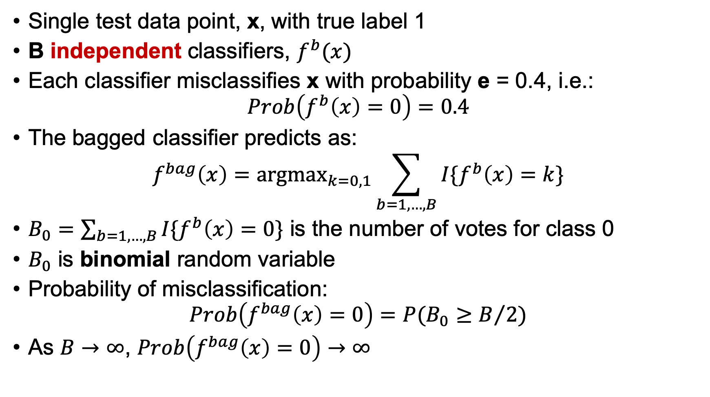
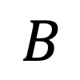
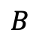
Why does bagging work?
Single test data point, x, with true label 1
B independent classifiers, $f^{b}(x)$
Each classifier misclassifies x with probability e = 0.4, i.e.:
$$Prob\left(f^{b}\left(x\right)=0\right)=0.4$$
The bagged classifier predicts as:
$$f^{bag}\left(x\right)={\text{argmax}}_{k=0,1}\sum_{b=1,…, B}{I\{f^{b}\left(x\right)=k\}}$$
$B_{0}=\sum_{b=1,…, B}{I\{f^{b}\left(x\right)=0\}}$ is the number of votes for class 0
$B_{0}$ is binomial random variable
Probability of misclassification:
$$Prob\left(f^{bag}\left(x\right)=0\right)=P(B_{0}≥B/2)$$
As $B→∞$, $Prob\left(f^{bag}\left(x\right)=0\right)→∞$
$$B$$
$$B$$

Slide 12
When should use Bagging?
High-variance classifiers, e.g., decision trees.
Bagging reduces variance by providing an alternative approach to regularization.
Even if each of the learned classifiers are individually overfit, they are likely to overfit to different things.
Through voting, we can overcome a significant portion of this overfitting.
In practice, bagging tends to reduce variance and increase bias.

Slide 13
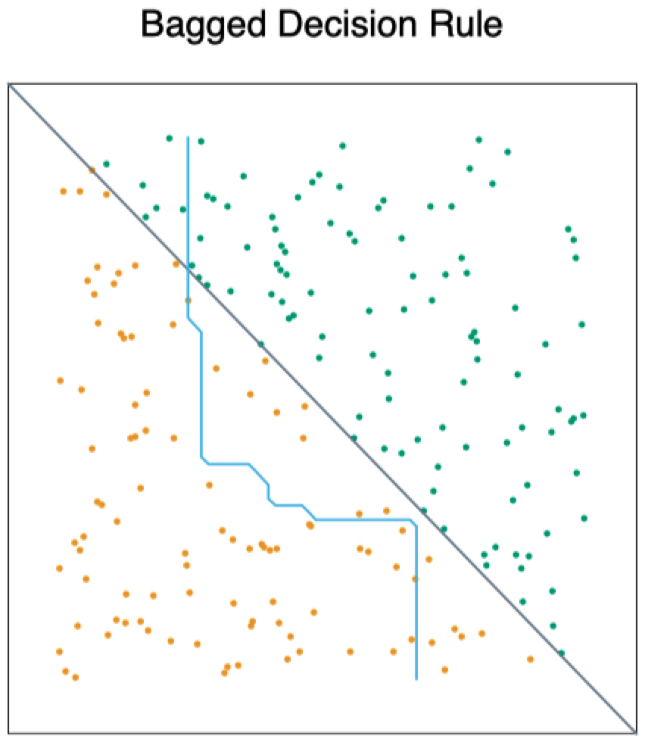
Final words on Bagging
Advantages
Reduces model variance
Trivial to implement and use
Caveats
Destroys any interpretability in the base model
May not capture simple patterns

Slide 14
Random Forest
Similar to Bagging Decision Trees except:
https://support.bccvl.org.au/support/solutions/articles/6000083217-random-forest

Slide 15
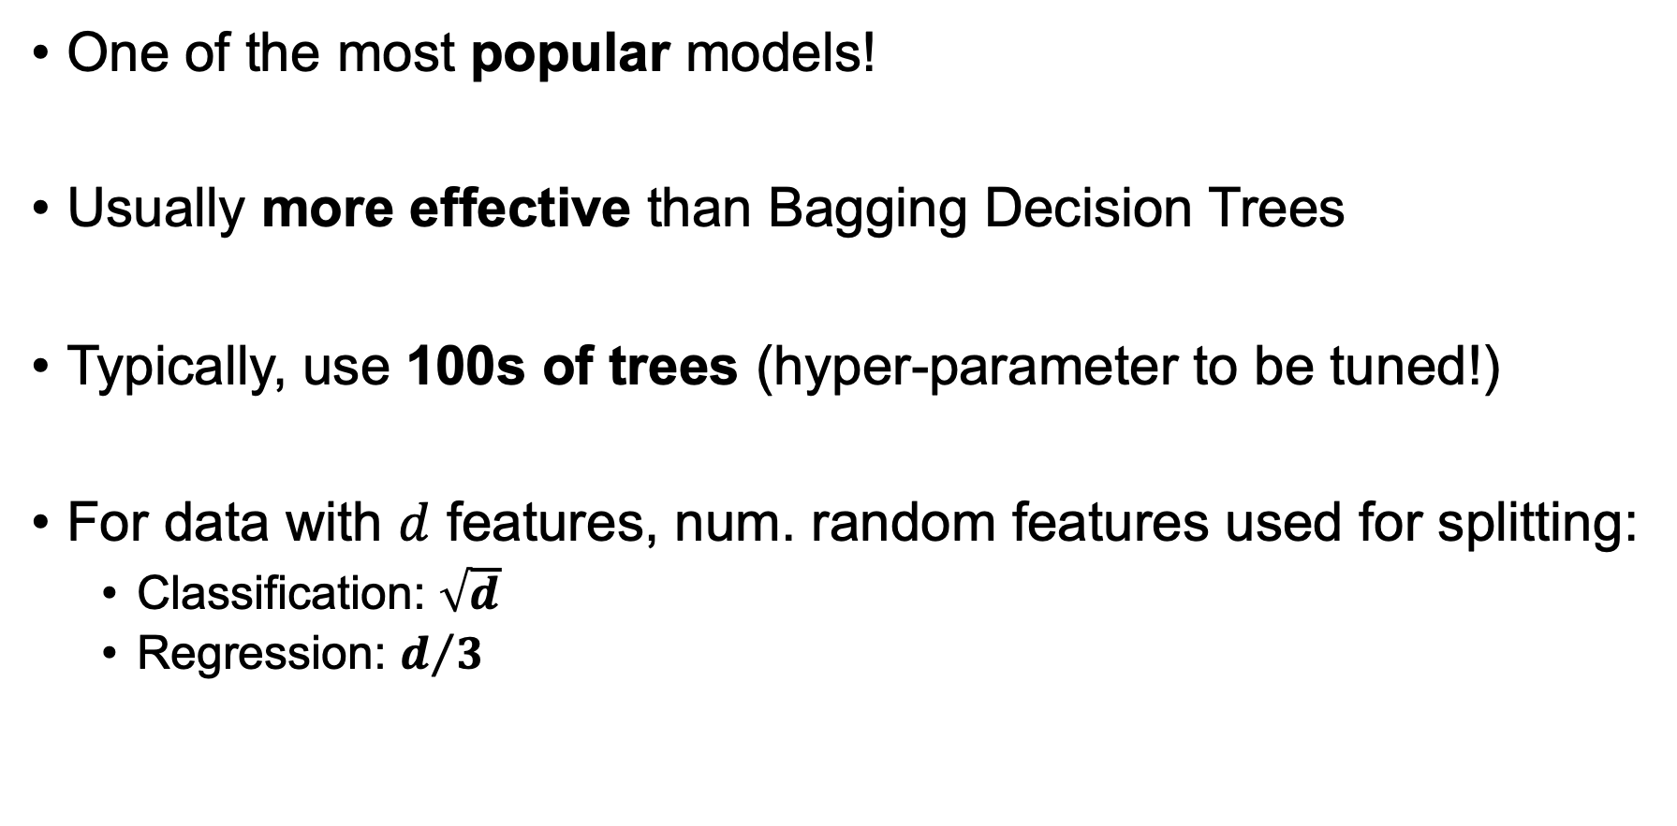
Random Forest
One of the most popular models!
Usually more effective than Bagging Decision Trees
Typically, use 100s of trees (hyper-parameter to be tuned!)
For data with $d$ features, num. random features used for splitting:
Classification: $\sqrt{d}$
Regression: $d/3$

Slide 16
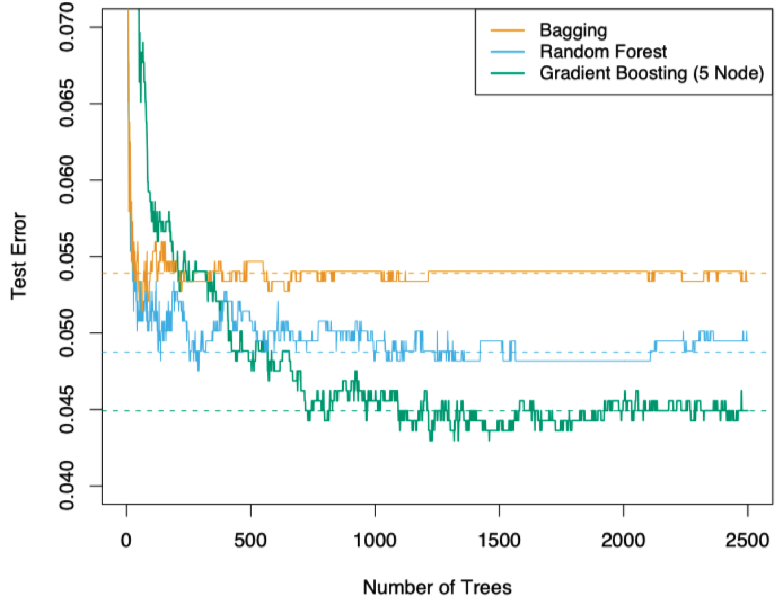
Example: Spam classification
Dataset of 4000 emails: y = (spam, not spam)
x = % of words equal to ’business’, ‘address’, etc.;
average length of uninterrupted sequences of capital letters, …
Ignore this for now

Slide 17
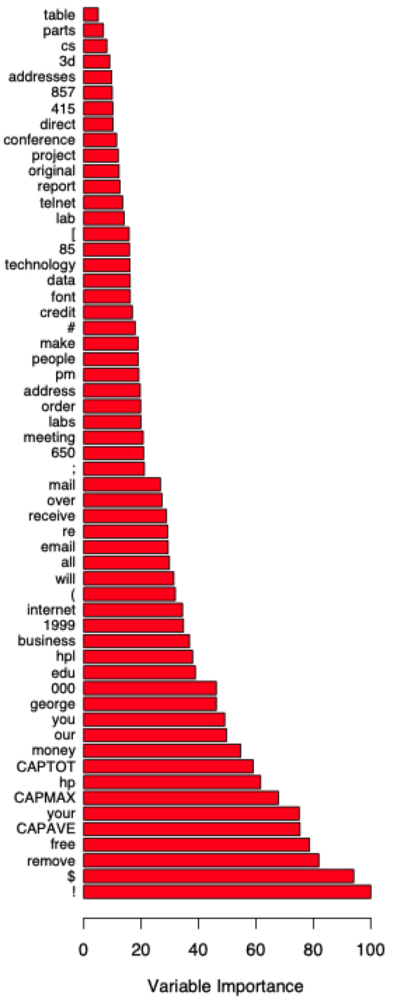
Random Forest: Feature Importance
Spam Email classification dataset
words

Slide 18
Final words on RF
Advantages
Feed it data as is without preprocessing
Fast training because of feature sampling!
Easy parallel training and prediction
Caveats
Not suitable for sparse data (why?)

Slide 19
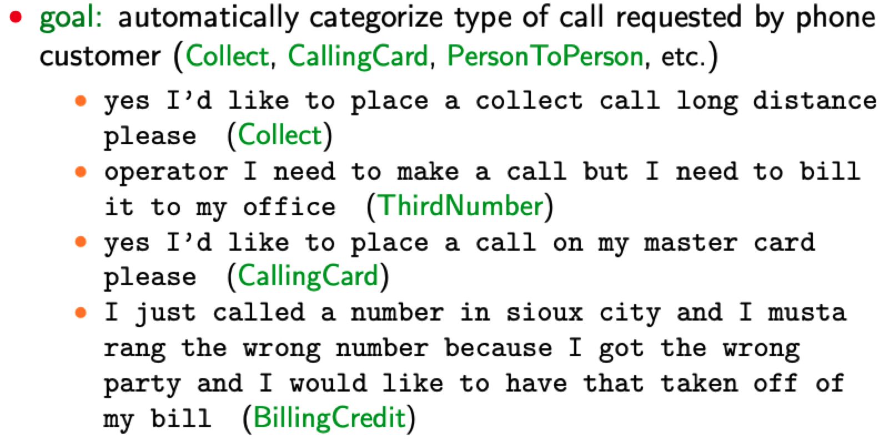
Boosting: “How May I Help You?”
Theory and Applications of Boosting by Schapire (NIPS 2007 tutorial)

Slide 20
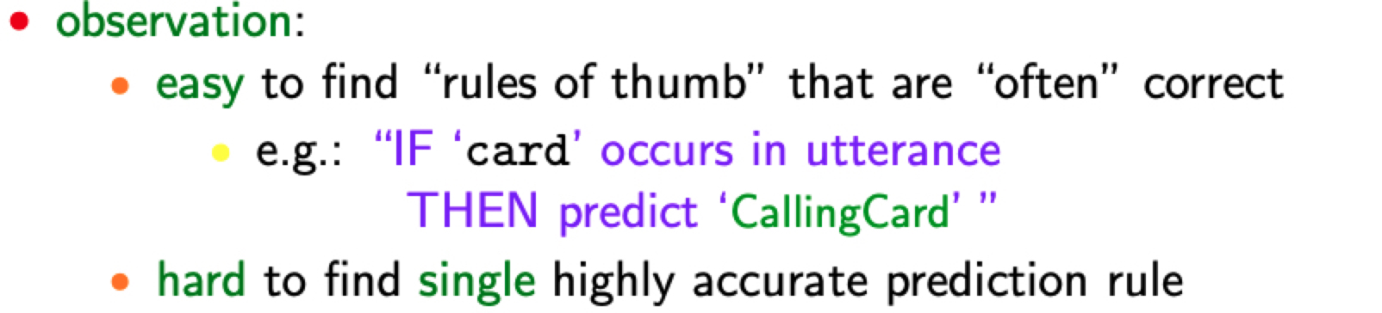
Boosting: “How May I Help You?”
Theory and Applications of Boosting by Schapire (NIPS 2007 tutorial)

Slide 21
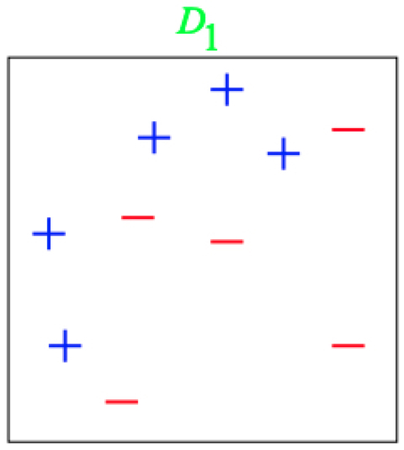
Boosting: A Toy Example
“rule of thumb” classifiers = vertical or horizontal half-planes

Slide 22
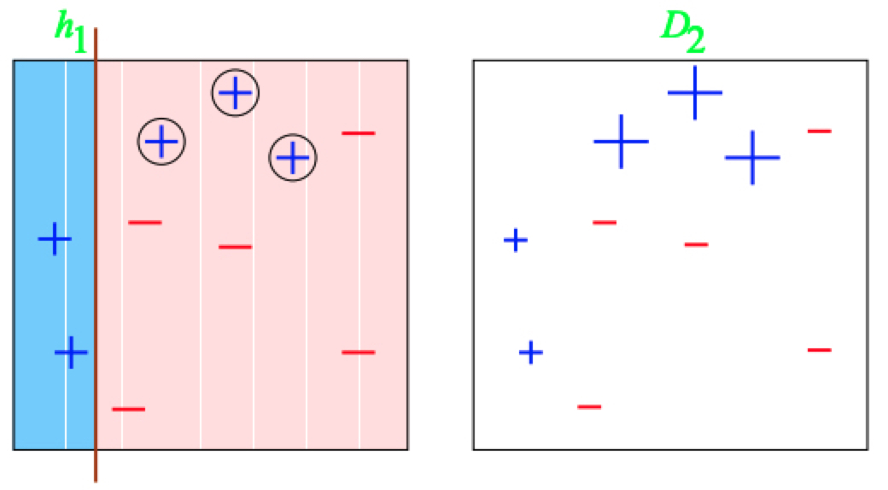
Boosting: A Toy Example
Size of the data point: penalty for misclassifying the point
“rule of thumb” classifiers = vertical or horizontal half-planes

Slide 23
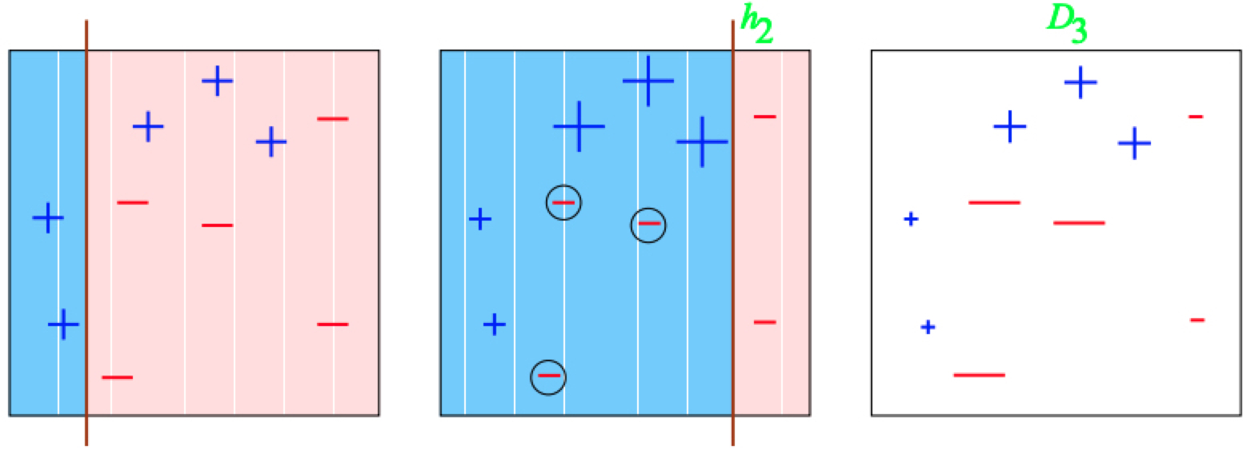
Boosting: A Toy Example
Size of the data point: penalty for misclassifying the point
“rule of thumb” classifiers = vertical or horizontal half-planes

Slide 24
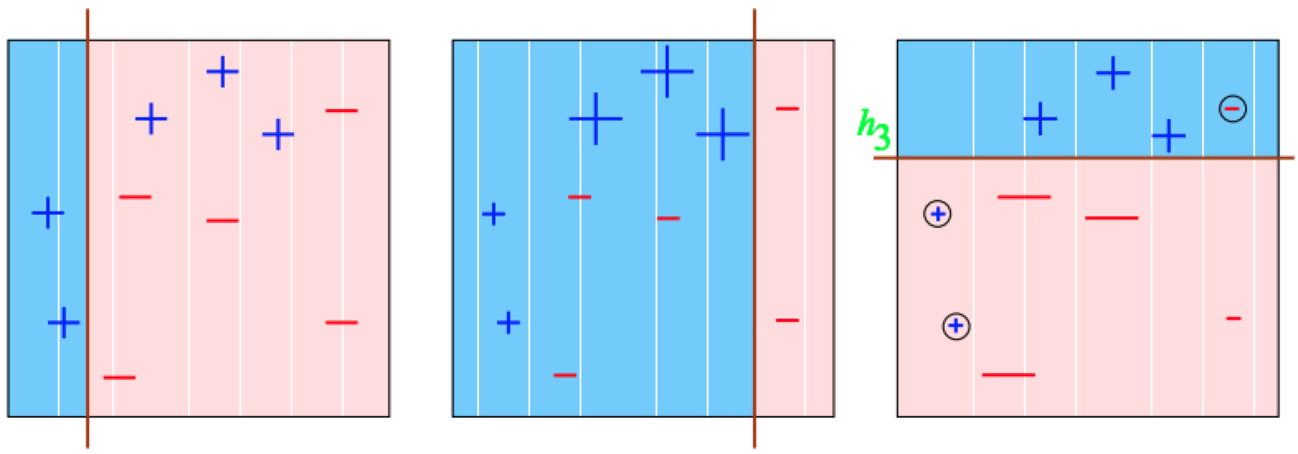
Boosting: A Toy Example
Size of the data point: weight, penalty for misclassifying the point
“rule of thumb” classifiers = vertical or horizontal half-planes

Slide 25
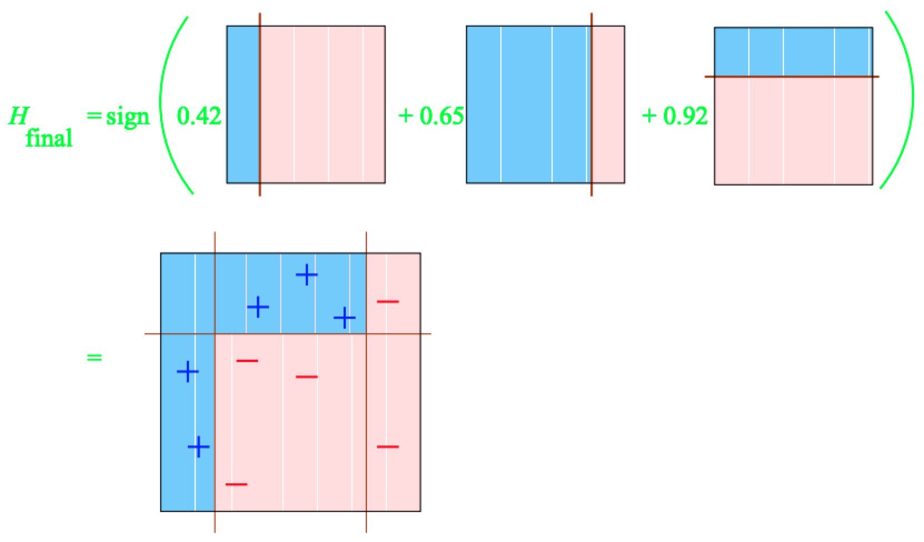
Boosting: A Toy Example

Slide 26
Boosting in a Nutshell
A general method of converting rough rules of thumb into highly accurate prediction rule.
Technically:
assume given “weak” learning algorithm that can consistently find classifiers (“rules of thumb”) at least slightly better than random, say, accuracy ≥ 55%
given sufficient data, a boosting algorithm can provably construct single classifier with very high accuracy

Slide 27
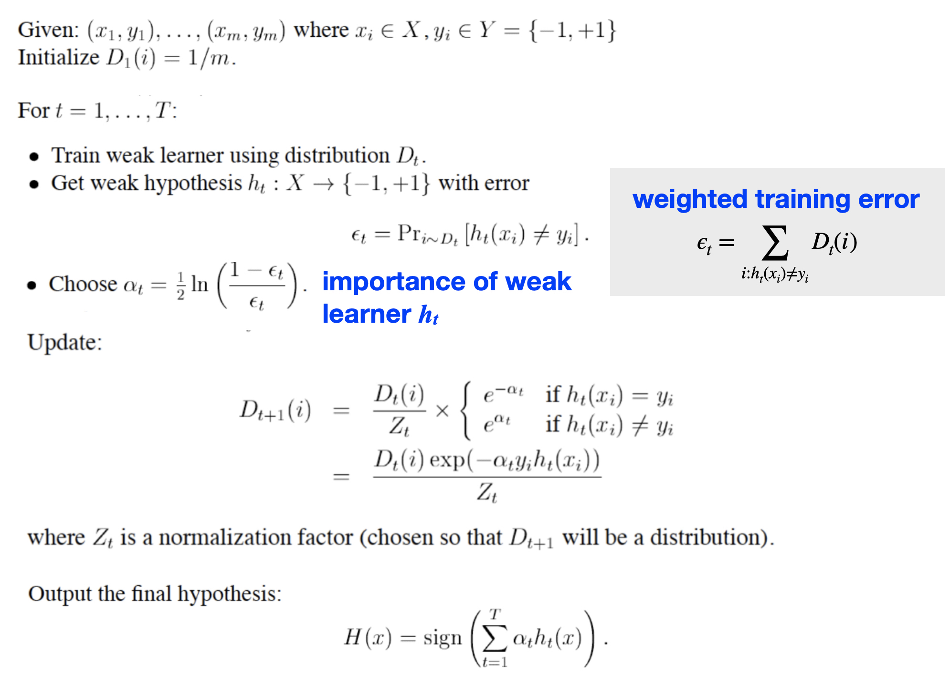

Slide 28
Example: Spam classification
Dataset of 4000 emails: y = (spam, not spam)
x = % of words equal to ’business’, ‘address’, etc.;
average length of uninterrupted sequences of capital letters, …
Boosting outperforms Random Forests

Slide 29
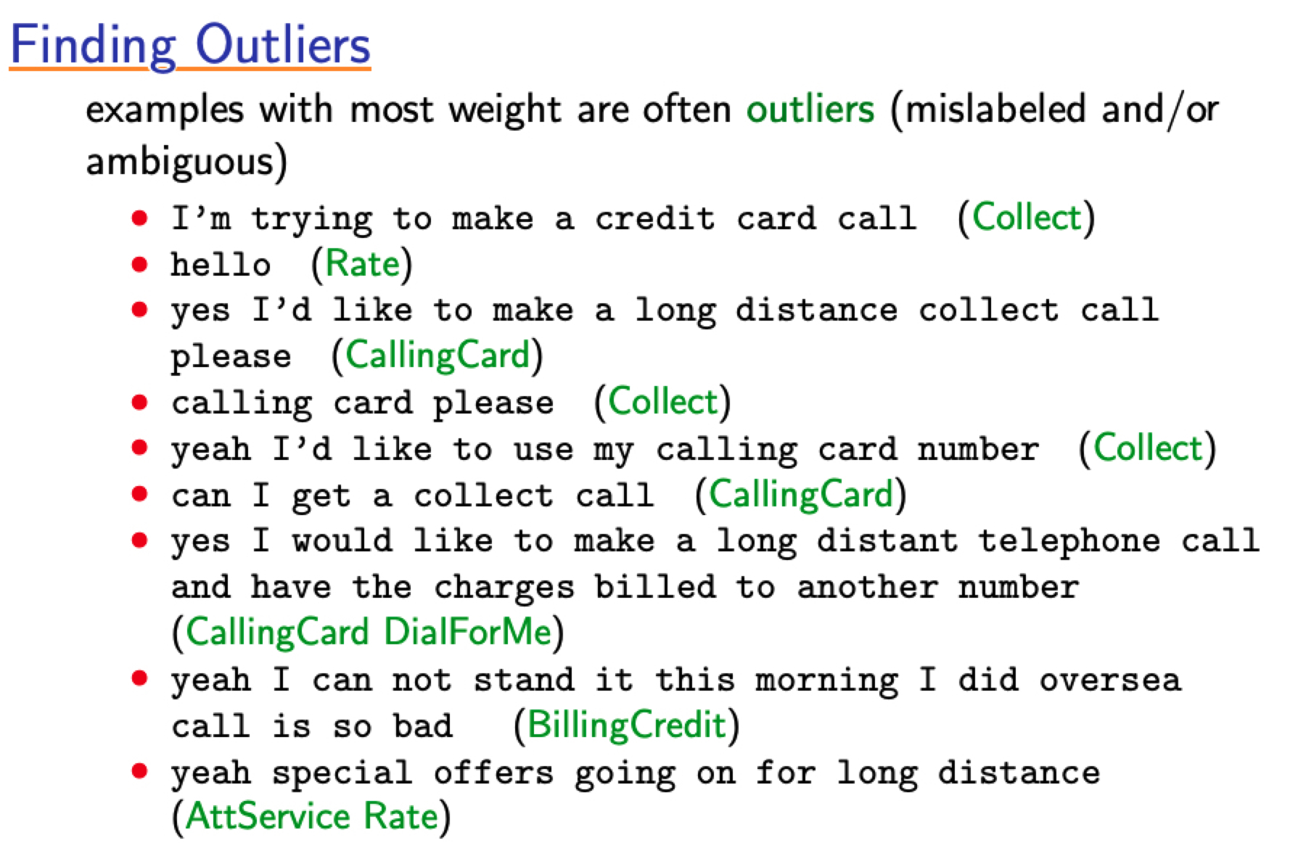
Finding Outliers with Boosting

Slide 30
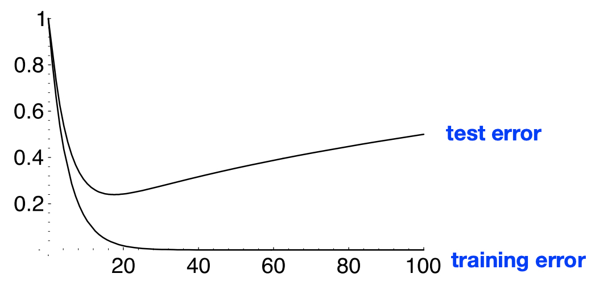
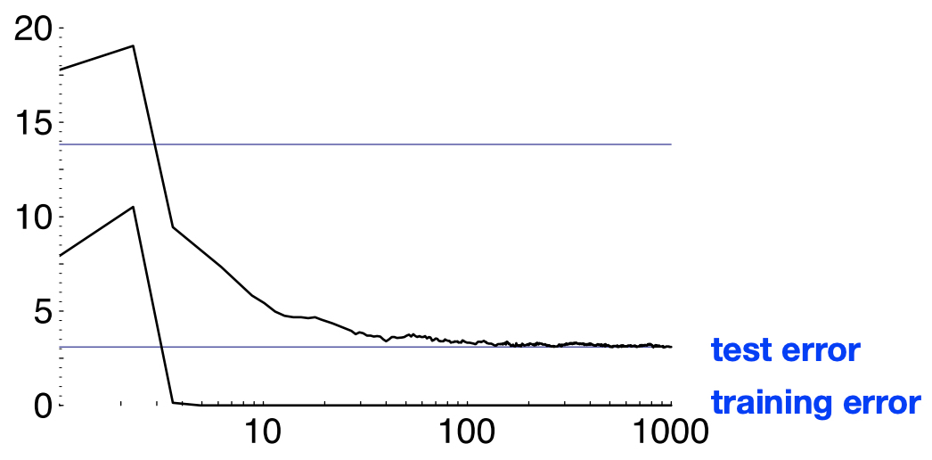
Boosting does not overfit in practice
Theory
Practice

Slide 31
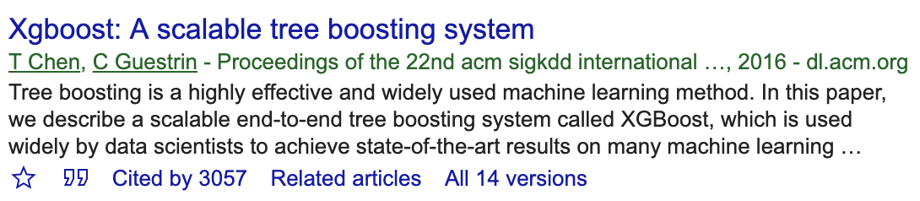


https://github.com/dmlc/xgboost
Very efficient, extensive tree boosting code by Tianqi Chen (UW)
A standard tool in data science competitions
Easy to parallelize and run on billion-scale problems

Slide 32
Final words on Boosting
Advantages
Fast and simple
Flexible: can work with any weak learner
Handles various feature types
Strong theoretical foundations
Caveats
Overfits if weak learner is too complex

Slide 33
Comparing Ensembles: Data
complete training set over weighted data
Based on https://quantdare.com/what-is-the-difference-between-bagging-and-boosting/

Slide 34
Comparing Ensembles: Training
Based on https://quantdare.com/what-is-the-difference-between-bagging-and-boosting/

Slide 35
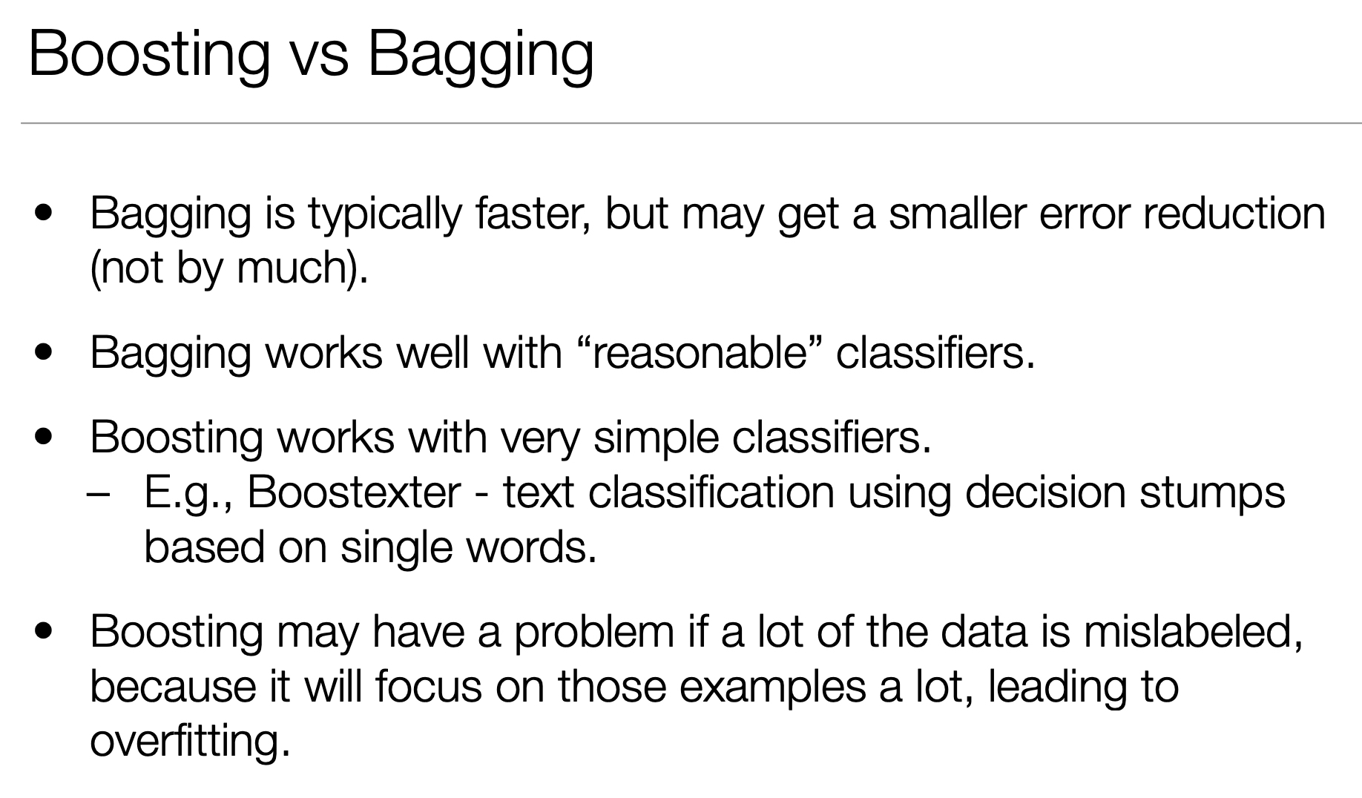
Slide from Edith Law at U Waterloo

Slide 36
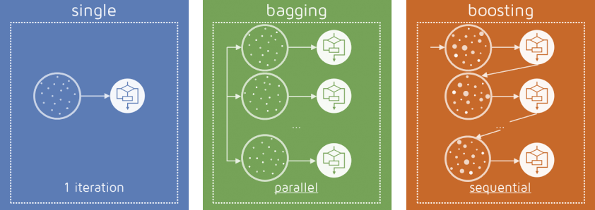
Recap
Ensemble methods are a must-try
Bagging: average models trained on bootstrap samples
Good bagging: Random Forests
Boosting: sequence of models that correct for remaining mistakes
Great boosting: xgboost

Slide 37
Data prep
https://developers.google.com/machine-learning/data-prep/
https://developers.google.com/machine-learning/crash-course/representation/cleaning-data
https://developers.google.com/machine-learning/crash-course/feature-crosses/encoding-nonlinearity
https://developers.google.com/machine-learning/crash-course/feature-crosses/crossing-one-hot-vectors

